Slide 1
Bibek Dhungel
Anirudh
Dixa
Harshith
Paderborn | 7.04.2021

Slide 2
Data
HOW???
Data- Infrastructure
Insights

Slide 3
Data Infrastructure?
What is??
Systematic Technology process set-up
To Acquisition – Storage – Maintenance of DATA
To extract useful Insights.

Slide 4
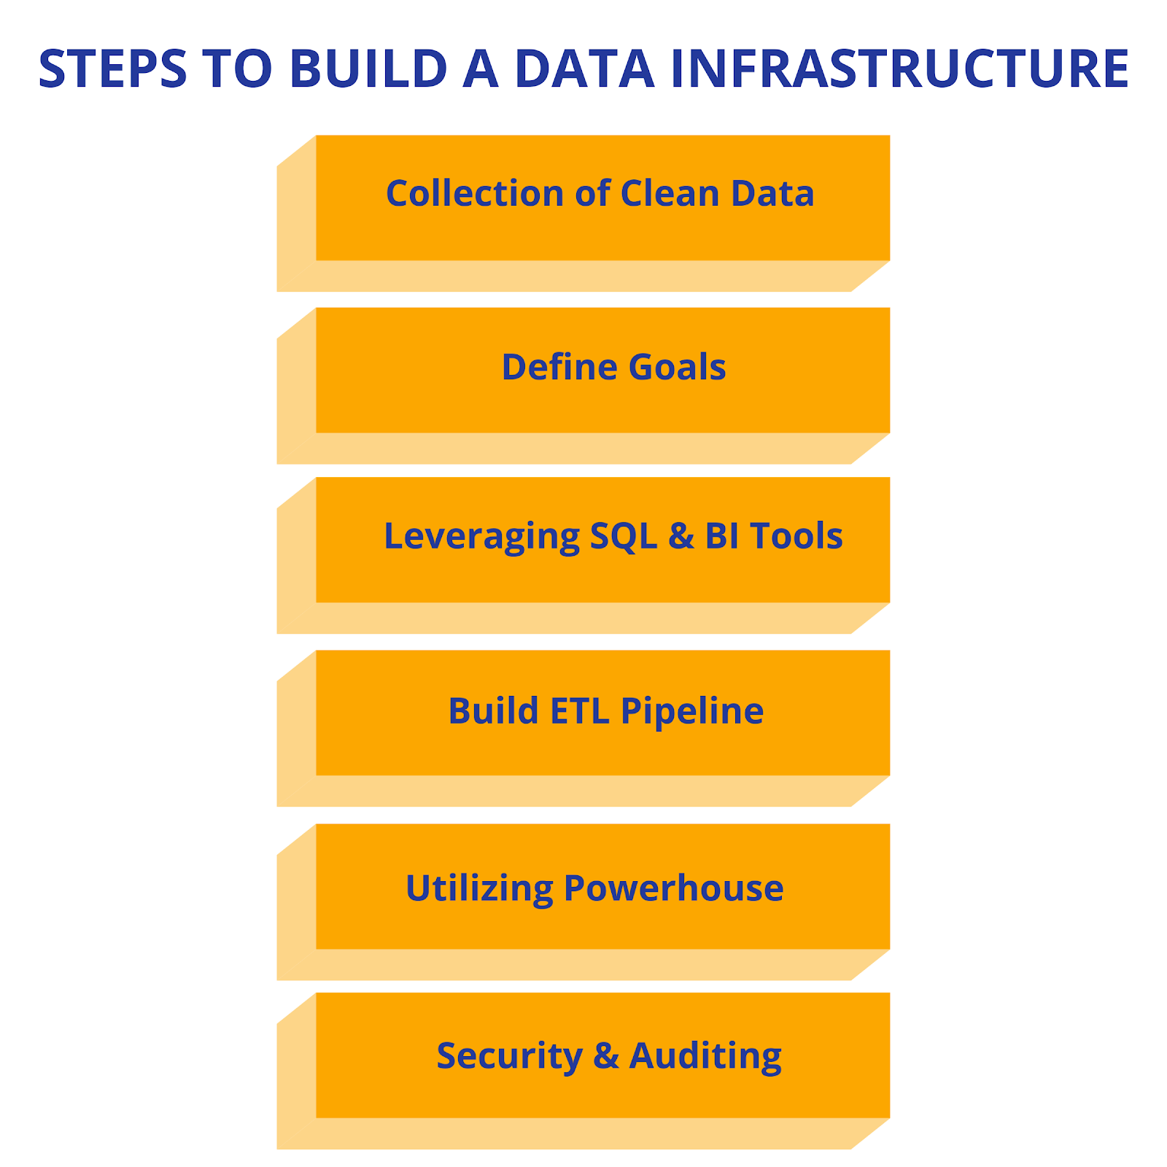
Data Infrastructure
How ??

Slide 5
Types of Data Infrastructure
Data Ingestion : Infrastructure to transport Data.
Data Access : Infrastructure to retrieve – modify – copy Data.
API Integration : Infrastructure to support interaction between front-end and back-end.
Data Storage and Processing : Infrastructure to store data and analyze.
Data Quality and Security : Infrastructure to support Efficiency and Robustness Data.
Data Visualization : Infrastructure to generate Data Reports/Dashboards.

Slide 6



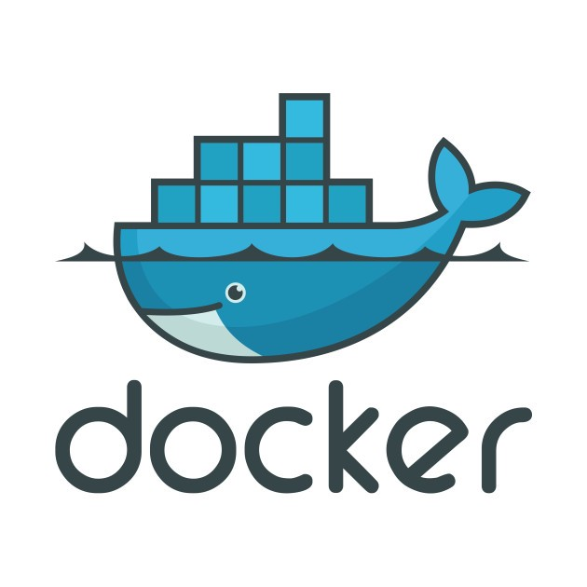
Data Infrastructure Tools
Ansible includes configuration management, application deployment, cloud provisioning.
Puppet lets users define the state they require to form the infrastructure and automating the system.
Docker lets the user focus on continuous integration and deployment of code
Selenium lets users create quick bug-fixing-scripts along with automated bug fixing mechanisms.

Slide 7
Thank You..
Questions?

